Slide 1

Note: The data and information in this document is reflective of a hypothetical situation and client. This document is to be used for KPMG Virtual Internship purposes only.
Sprocket Central Pty Ltd
Data analytics approach
[Division Name] - [Engagement Manager], [Senior Consultant], [Junior Consultant]

Slide 2
Note: The data and information in this document is reflective of a hypothetical situation and client. This document is to be used for KPMG Virtual Internship purposes only.
Agenda
Introduction
Data Exploration
Model Development
Interpretation

Slide 3
Note: The data and information in this document is reflective of a hypothetical situation and client. This document is to be used for KPMG Virtual Internship purposes only.
Introduction
New Customers Analysis
Analyze the following factors for new customers:
Age distribution criteria
Bike Purchase in 3 years
Job Industry Category
Car owns by the new customer

Slide 4
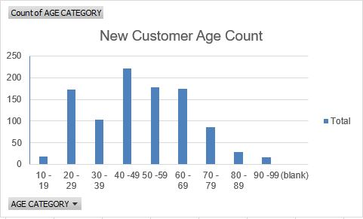
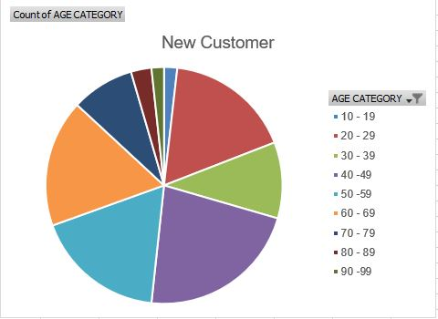
Note: The data and information in this document is reflective of a hypothetical situation and client. This document is to be used for KPMG Virtual Internship purposes only.
Data Exploration
Plots of Age Distribution for New Customers:
Place any information about this point here.

Slide 5
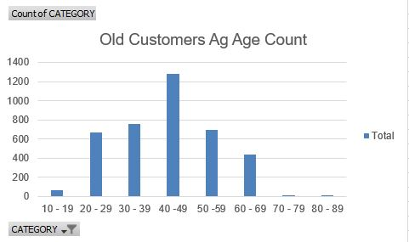
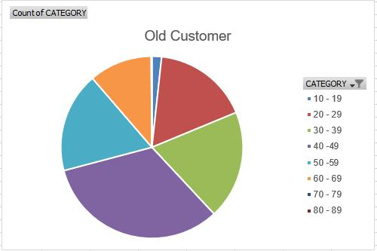
Note: The data and information in this document is reflective of a hypothetical situation and client. This document is to be used for KPMG Virtual Internship purposes only.
Model Development
Plots of Age Distribution for Old Customers:

Slide 6
Note: The data and information in this document is reflective of a hypothetical situation and client. This document is to be used for KPMG Virtual Internship purposes only.
Data Exploration
Analysis - Age Distribution
It can be observed from the plots that most of the new customers belong to the age group of 40 – 49 as the same is noticed for the old customer data also. Hence we infer that, people belonging to the this age group are most likely to purchase frequently
The ratio of purchase has increased in the new customer data for the age group belonging to the range 60 – 69.
The data distribution remains same for the age group of 20 – 29 in both the data.
It looks like the percentages of under 25 years old not really change.

Slide 7
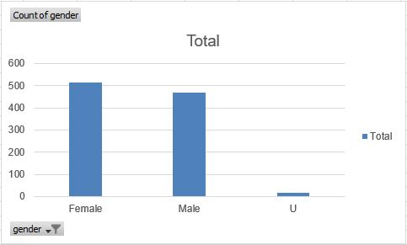
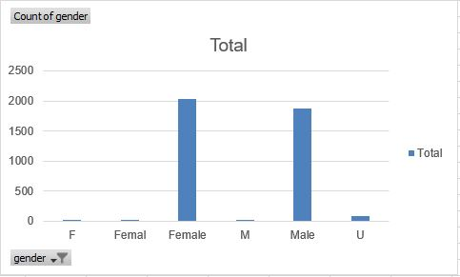
Note: The data and information in this document is reflective of a hypothetical situation and client. This document is to be used for KPMG Virtual Internship purposes only.
Model Development
NEW CUSTOMER PURCHASE
Purchase History of Bikes (last 3 years)
We can see that around 51% (25,212 bikes) females purchased a bike within the last three years and the male purchase sums up to 47% (23,765 bikes).
The target audience for our marketing and advertising should be inclined to provide focus on females than males.
OLD CUSTOMER PURCHASE

Slide 8
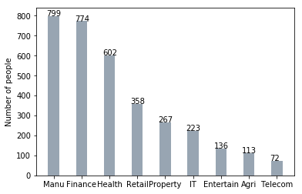
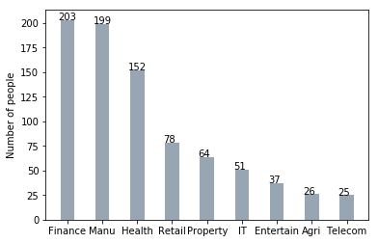
Note: The data and information in this document is reflective of a hypothetical situation and client. This document is to be used for KPMG Virtual Internship purposes only.
Interpretation
Job industry
Most of the new customers belong to the Finance industry and Manufacturing customers still stands among the top two positions.
Rest of the industries seem to remain in the same positions.

Slide 9
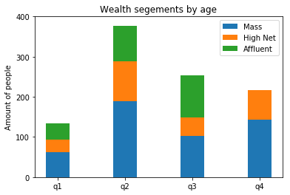
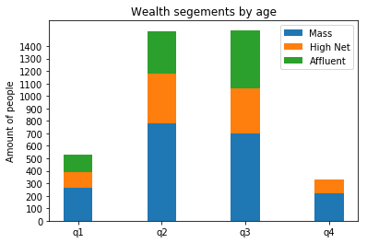
Note: The data and information in this document is reflective of a hypothetical situation and client. This document is to be used for KPMG Virtual Internship purposes only.
Interpretation
Wealth segment
We notice that in all the age groups, the number of Mass Customers remains the highest, so it would be wise to provide extra focus to this area.
The next are of focus should be weon High Net Customer Category.
Then followed by the Affluent Customers.

Slide 10
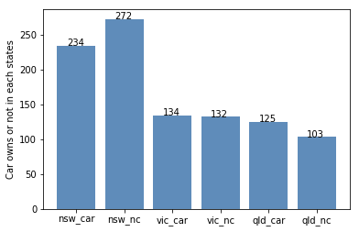
Note: The data and information in this document is reflective of a hypothetical situation and client. This document is to be used for KPMG Virtual Internship purposes only.
Interpretation
Wealth segment
VIC and QLD cars seem to have more customers that own car, so NSW should be considered.
NSW cars category should be prioritized the most for now, since numbers of customers that don’t own a car is significantly larger than the number of customers who own one.

Slide 11
Note: The data and information in this document is reflective of a hypothetical situation and client. This document is to be used for KPMG Virtual Internship purposes only.
Appendix

Slide 12
Note: The data and information in this document is reflective of a hypothetical situation and client. This document is to be used for KPMG Virtual Internship purposes only.
Appendix
This is an optional slide where you may place any supporting items.

